Slide 1
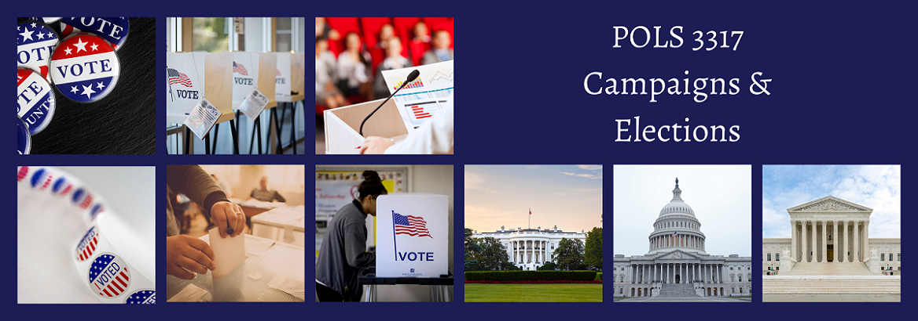
Modern Campaign Strategies

Slide 2
Joel Bradshaw’s 4 Propositions for a Successful Campaign Strategy
3 groups: the candidate’s base, the opponent’s base, and undecided
Data: Past election results, data from registered voter lists, and survey research make it possible to identify who falls into the three groups
It is neither possible nor necessary to get the support of al people everywhere to win the election
Once you identify how to win, you can create the circumstances to bring about this victory

Slide 3
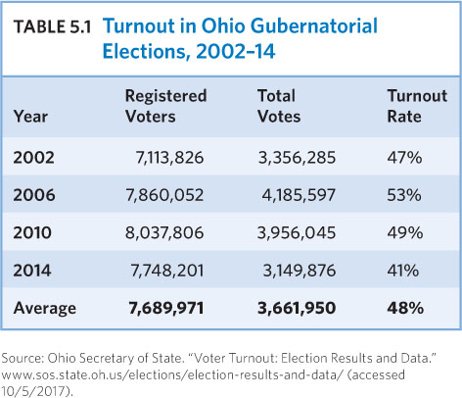
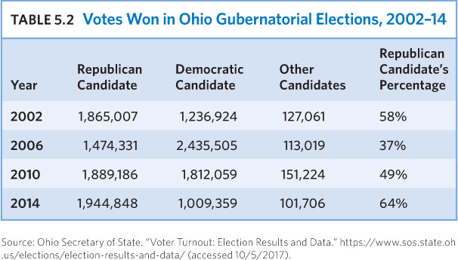
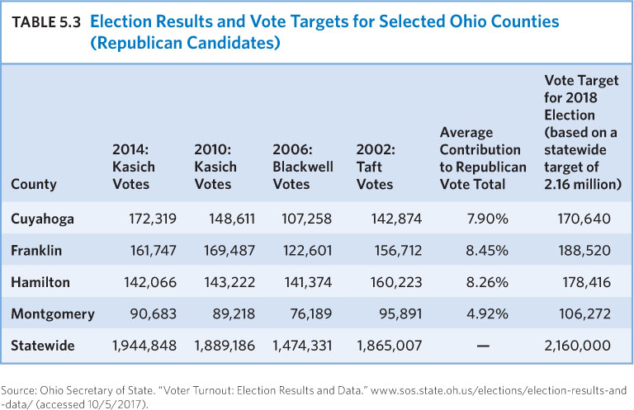
Vote Targets
Vote targets
Base vote vs. Ceiling vote
  Ceiling – base = swing/persuadable voters
Notes:
https://www.polleverywhere.com/activities

Slide 4
Voter Targets
Voter Files
  Party
  Commercial vendors
  Local races: county registrar
  Microtargeting
    Combine voter file information with commercial data collected on individuals to result in individual-level targeting
    Private enterprise data (not new) being used in politics

Slide 5
Context of Voter Targeting
Beyond polling data and accurate voter list: reality
Challenger vs. Incumbent
  Incumbent:
    Referendum
    Associate prevailing conditions with incumbent
    More difficult to persuade voters
    Defend record
  Challenger:
    Try to convince people the incumbent has done a poor job
    People prefer someone they know (name recognition)
Open-seat race
  Election with no incumbent running
Characteristics of Candidate’s Constituency
  Partisan appeals vs. candidate-related appeals

Slide 6
Strategic Campaign Decisions

Slide 7
Deciding to Run
Motivation
  Desire and commitment to running
  Reasons for running
  Family considerations
Resources
Ability to assemble a campaign organization
Opportunity
  Looking to maximize chances they will win
  Impact:
    Strategic politicians rarely run unless they calculate favorable odds
    Incumbents rarely face competition unless other factors are against them
  Biases a candidate will face (race, gender, etc.)

Slide 8
Messaging: Issue Priorities
Axelrod: What is your theory of the case?
  Filter you want to pass all of your messaging and all voter communication through
Considerations:
Typically focus most on one or two issues
  Framing – easy-to-understand terms
  Define what matters
  Most citizens only pay attention to the loudest moments
World events outside of the control of the candidate
Traditional Strengths of the Party
  Issue ownership
Candidate’s own personal experiences and reputation

Slide 9
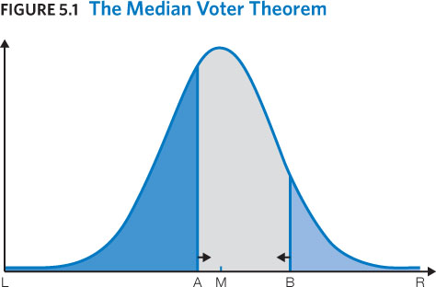
Messaging: Issue Positions
Energizing the vase vs. persuading citizens to adopt candidate point of view
Criticisms of Median Voter Theorem
Notes:
Talk through marijuana, health care, etc.

Slide 10
Rove and Axelrod: Taking Inventory
Story you are telling with an arc and theme
What are the elements of the story that you are going to tell and at what time?
Plan this out, write it down, revisit as reality changes
Inventory of:
  Campaign manager: gather as much information as possible on candidate and opponent
    Public records, statements, actions
  Identify strengths/vulnerabilities of candidate and opponent
  Choose priorities based on what mitigates weaknesses / heightens strengths
  Plan what opponent might say with potential responses
    Respond within the context of your message
Inventory of:
  How to tell these story elements

Slide 11
Whether to Attack
Considerations:
Candidate who is ahead in the polls is less likely to attack than candidate who is behind
Incumbents ahead in polls would likely only attack if opponent is gaining in the polls
  May risk giving name recognition and exposure to challenger if not well known
More common from challenger
  Calls incumbent record into question is common strategy
  Draws more media coverage than positive ads
Attacks can come from independent groups and party organizations

Slide 12
Where to Campaign
Model 1:
  Mobilize partisans
Model 2:
  Persuade independent and weakly partisan voters
Reality – candidates try to do both
Incumbents more likely to mobilize
Price per persuadable voter drives efforts

Slide 13
How to Campaign
The tactics – the means by which the strategic goals are accomplished
Ground game
  Campaign with fewer resources focus more on
  Surge in focus in the past decade
  Personal contact with voters is found to be significantly more effective
    Compared to: mail, phone calls by volunteers, phone calls from telemarketers, robo calls
  Rove and Axelrod:
    https://ttu.blackboard.com/bbcswebdav/pid-6368847-dt-content-rid-75417797_1/courses/79.202127/Axelrod%20and%20Rove%20Guide.pdf

Slide 14
Campaign Strategists
See Karl Rove and David Axelrod supplement https://ttu.blackboard.com/bbcswebdav/pid-6368847-dt-content-rid-75417797_1/courses/79.202127/Axelrod%20and%20Rove%20Guide.pdf
Start by volunteering or looking for entry-level positions with campaign or party
Fast pace means you can move up quickly
Survey different areas:
  Communication
  Field and voter contact (how to organize voter core)
  Fundraising
  Event planning
  Body person

